Slide 1
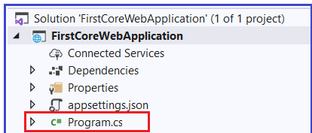
The Program.cs class file of our ASP.NET Core Web Application contains the following code.
public class Program
{
public static void Main(string[] args)
{
var builder = WebApplication.CreateBuilder(args);
// Add services to the container.
builder.Services.AddControllersWithViews();
builder.Services.AddSingleton<IEmployeeRepository, MockEmployeeRepository>();
var app = builder.Build();
// Configure the HTTP request pipeline.
if (!app.Environment.IsDevelopment())
{
app.UseExceptionHandler("/Home/Error");
// The default HSTS value is 30 days. You may want to change this for production scenarios, see https://aka.ms/aspnetcore-hsts.
app.UseHsts();
}
app.UseHttpsRedirection();
app.UseStaticFiles();
app.UseRouting();
app.UseAuthorization();
app.MapControllerRoute(
name: "default",
pattern: "{controller=Home}/{action=Index}/{id?}");
app.Run();
From the above image, you can see that the Program class contains a public static void Main() method. As we already know, when we create a console application in .net then by default the .NET Framework creates a class (i.e. Program class) with the Main Method. We also know that the Main method is the entry point for that console application execution.

Slide 2
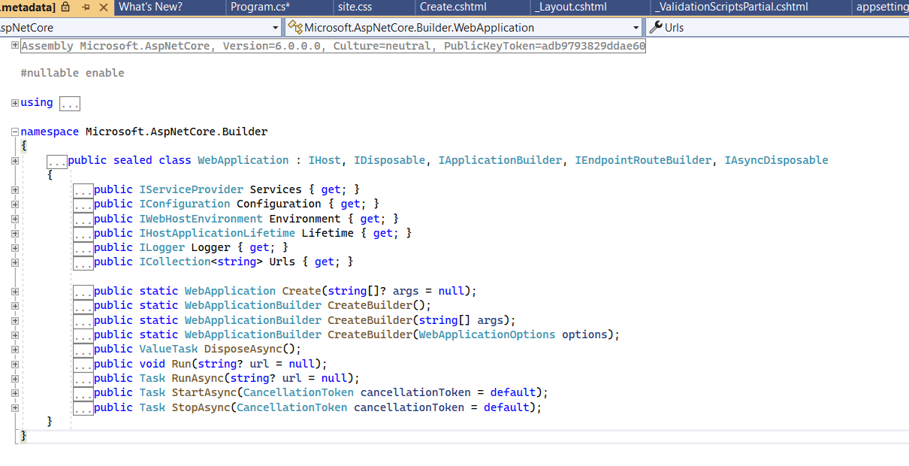
Why do we have a Main() method in ASP.NET Core?
The most important point that you need to keep in mind is, the ASP.NET Core Web Application initially starts as a Console Application and the Main() method is the entry point to the application. So, when we execute the application, first it looks for the Main() method and this is the method from where the execution starts. The Main() method then configures ASP.NET Core and starts it. At this point, the application becomes an ASP.NET Core web application.
If you further look at the body of the Main() method, then you will find that it makes a call to the CreatetBuilder() method by passing the command line arguments args as an argument as shown in the below image.
As shown in the below image, the CreateBuilder() method returns an object WebApplicationBuilder
It is a static class.
var builder = WebApplication.CreateBuilder(args);

Slide 3
Program class
What are the Tasks performed by CreateBuilder() method?
ASP.NET Core includes dependency injection (DI) that makes configured services available throughout an app. Services are added to the DI container with WebApplicationBuilder.Services, builder.Services in the preceding code.
When the WebApplicationBuilder is instantiated, many framework-provided services are added. builder is a WebApplicationBuilder in the following code:
C#
var builder = WebApplication.CreateBuilder(args); // Add services to the container. builder.Services.AddRazorPages(); builder.Services.AddControllersWithViews();
var app = builder.Build();
In the preceding highlighted code, builder has configuration, logging, and many other services added to the DI container.

Slide 4
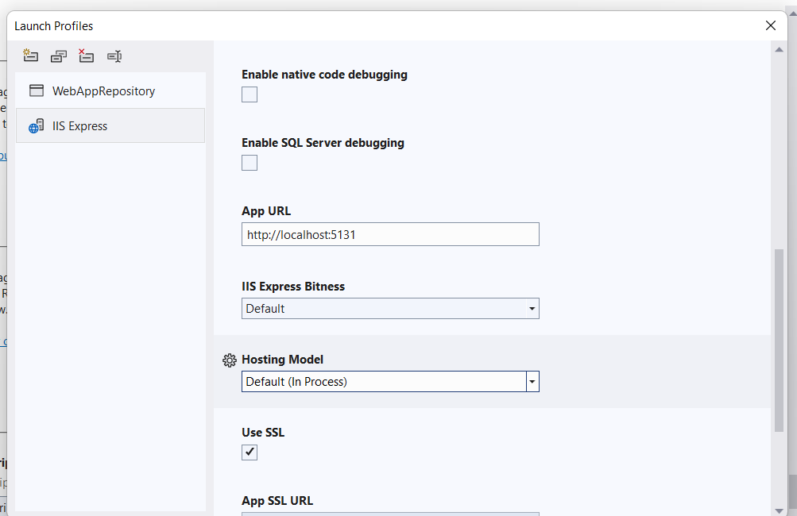
What are the Tasks performed by CreateBuilder() method?
An ASP.NET Core app runs with an in-process HTTP server implementation. The server implementation listens for HTTP requests and surfaces them to the app as a set of request features composed into an HttpContext.
InProcess hosting model
Note: When we create a new ASP.NET Core Web application by using any template, by default the project file is created with InProcess hosting which is used for hosting the application in IIS or IIS Express scenarios.
How to verify this?
In order to verify the same, open the project properties. Right-click on your project and select the properties option from the context menu. Once you open the properties window, then select the Debug and have a look at the value of the Hosting Model drop-down list as shown in the below image. The drop-down list contains three values i.e. Default (InProcess),

Slide 5
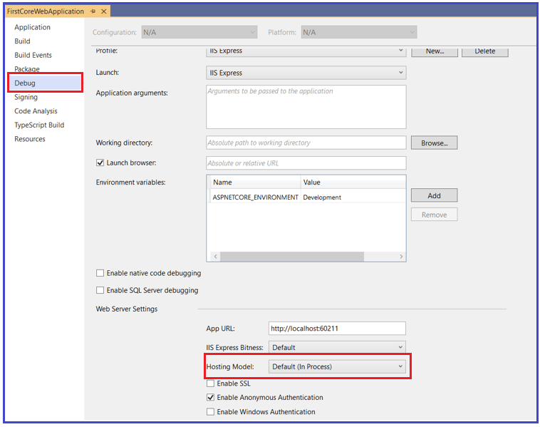
This Confirm that by default it uses In Process hosting model.

Slide 6
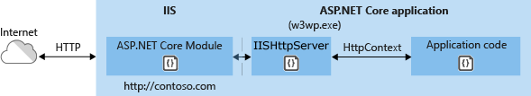
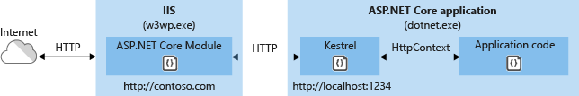
How to Configure InProcess hosting in ASP.NET Core?
To configure the InProcess hosting for ASP.NET Core Web application there is only one simple setting, just add the <AspNetCoreHostingModel> element to the application project file with a value of InProcess. To do so, just right-click on your application from the solution explorer and then click on the “Edit Project File” option from the context menu as shown in the below code.
Once you open the Application Project file then modify it as shown below. As you can see, here we add <AspNetCoreHostingModel> element and set its value to InProcess. The other possible value for this element is OutOfProcess.

Slide 7
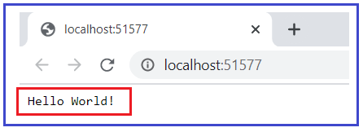
What happens when we set the Hosting model as InProcess?
In case of InProcess hosting (i.e. when the CreateBuilder() sees the value as InProcess for the AspNetCoreHostingModel element in the project file), behind the scene the CreateBuilder() method internally calls the UseIIS() method. Then host the application inside the IIS worker process (i.e. w3wp.exe for IIS and iisexpress.exe for IISExpress).
From the performance point of view, the InProcess hosting model delivers significantly higher request throughput than the OutOfProcess hosting model.
The process name that will be used to execute the application is w3wp in the case of IIS. Similarly, if it is IIS Express then the process name will be iisexpress.
Let’s Confirm this:
Now if you will run the application, then you will see the following hello world message in the browser.

Slide 8
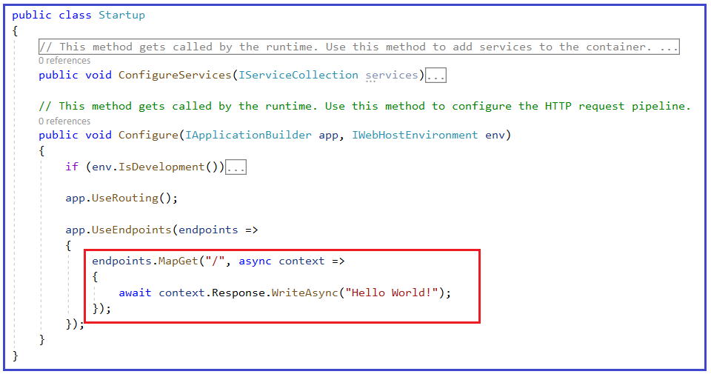


You are getting the above message from the following Startup class
app.UseEndpoints(endpoints =>
{
endpoints.MapGet("/", async context =>
{
await context.Response.WriteAsync("Worker Process Name : " + System.Diagnostics.Process.GetCurrentProcess().ProcessName);
});
});
Take mvc PROJECT
This is because by default Visual Studio uses IISExpress when we run an application as shown in the below image.
To display the process name in the browser you need to use the System.Diagnostics.Process.GetCurrentProcess().ProcessName within the Startup as shown below.
What is IIS Express?
Now when we run the application from visual studio, and it should display the message in the browser as shown below.
The IIS Express is a lightweight, self-contained version of IIS. It is optimized for web application development. The most important point that you need to remember is we use IIS Express only in development, not on production. In production we generally use IIS

Slide 9
namespace _01MVC
{
public class Program
{
public static void Main(string[] args)
{
var builder = WebApplication.CreateBuilder(args);
// Add services to the container.
builder.Services.AddControllersWithViews();
var app = builder.Build();
// Configure the HTTP request pipeline.
if (!app.Environment.IsDevelopment())
{
app.UseExceptionHandler("/Home/Error");
// The default HSTS value is 30 days. You may want to change this for production scenarios, see https://aka.ms/aspnetcore-hsts.
app.UseHsts();
}
app.UseHttpsRedirection();
app.UseStaticFiles();
app.UseRouting();
app.UseAuthorization();
/* app.MapControllerRoute(
name: "default",
pattern: "{controller=Home}/{action=Index}/{id?}");
*/
app.UseEndpoints(endpoints =>
{
endpoints.MapGet("/", async context =>
{
await context.Response.WriteAsync("Worker Process Name : " + System.Diagnostics.Process.GetCurrentProcess().ProcessName);
});
});
app.Run();
}
}
}
Steps
Create MVC Application

Slide 10
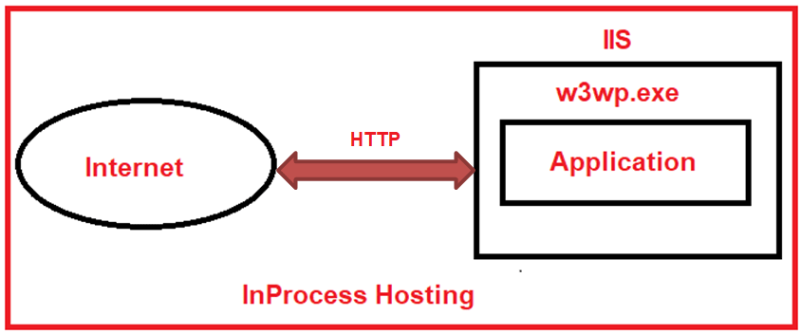
Why InProcess Hosting Gives Better Performance that the OutOfProcess Hosting Model?
In the case of OutOfProcess hosting, there are 2 web servers
An internal web server and
One external web server.
The internal web server is called Kestrel and the external web server can be IIS, Nginx, or Apache. With the InProcess hosting model, there is only one web server i.e. IIS. So, in the case of the InProcess hosting model, we do not have the performance penalty for navigating the requests between the internal and external web servers. This is the reason why the InProcess hosting model delivers significantly higher request throughput than the OutOfProcess hosting model.

Slide 11
Q1. What is InprocessHosting?
Q2. In case of InProcess hosting (i.e. when the CreateBuilder() sees the value as InProcess for the AspNetCoreHostingModel element in the project file), behind the scene the CreateBuilder() method internally calls the ________ method. Then host the application inside the IIS worker process (i.e. ________for IIS and________for IISExpress).
Q3. what is IISExpress
Q4. Why InProcess Hosting Gives Better Performance that the OutOfProcess Hosting Model?
Q5. In the case of OutOfProcess hosting, there are _____(option: ➔1,2,3)of web servers
Q6. The internal web server is called ____and the external web server can be _______ ,_____________ or ____________

